Slide 1
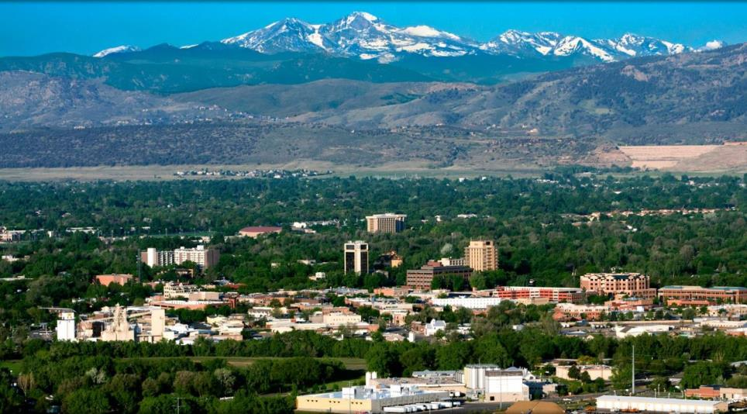
Demand Management Options for Commercial Customers
Pablo Bauleo, Ph.D.
Sr. Energy Services Engineer
Fort Collins Utilities

Slide 2
Outline
Electric bill components
  Facility Demand vs Coincident Peak Demand
  PRPA Peak Hour (a.k.a “Coincident Peak”)
Tools for you
  Email notifications, Peakload & OpenADR
  Coming soon: SMS notices

Slide 3
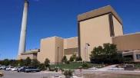
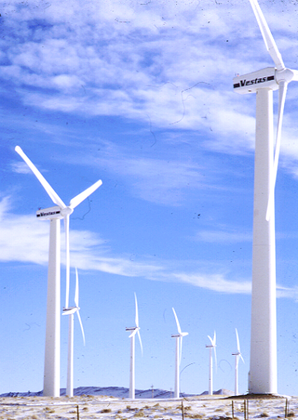
PRPA and
Fort Collins Utilities
115 – 230 kV
13.2 kV
Energy
Supply
Transmission
Distri-bution
Customers
Platte River
Power Authority
Fort Collins
Utilities
PRPA services Fort Collins, Longmont, Estes Park and Loveland

Slide 4

Electric Bill Components
Large Commercial & Industrial
Energy: (~$0.04/kWh, seasonal dependent)
  How many kWh you used
  Known at the end of the month
Facility demand: (~$9.5/kW*)
  Your highest hourly demand in the month
  Known at the end of the month
Coincident peak (~$14.5/kW* summer, or ~$11/kW* winter)
  Summer is June, July, August and September
  Your demand at the time of PRPA monthly peak (peak hour)
  Known at the end of the month
(*) The cost is set by your specific electric rate, like E300, E400, etc.
Notes:
Any questions so far?

Slide 5
Facility Demand and Coincident Peak Demand
Facility Peak
(~$9.5/kW)
PRPA Peak Hour
(~$11/kW or $14.5/kW)
Day of the Month

Slide 6
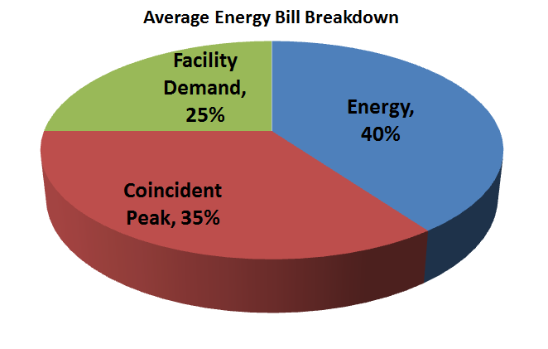
Energy Bill Breakdown
What can I do to save?
Set by only 1 hour
of the month
Set by all hours
of the month
Have to schedule processes every day of the month
Have to be efficient all hours of the month
Set by only 1 hour
of the month
Have to shift processes,
maybe 8 hrs/month

Slide 7
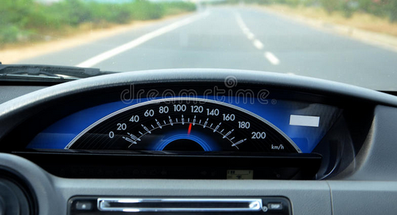
Peak Hour and the end of the month
The “Peak Hour” is the hour of the month when most electricity was used by the Sister Cities.
It is equivalent to “Which milestone will you hit your fastest speed in your commute between Fort Collins and Longmont?”
You need to be at your destination to know where was the fastest speed (the peak) and where it was (the peak hour) ?
Notes:
Any questions so far?

Slide 8

Peak Hour Occurrence
Tend to happens on weekdays
  Rare (but known) weekend Peak Hours
Summer (AC load)
  Between 2 to 6 pm on a very hot afternoon
Winter (Lights + Electric Heat)
  Between 6 to 9 pm on a very cold evening
Spring/Fall
  Anytime from noon to 9 pm (weather driven)
Prague Astronomical Clock

Slide 9
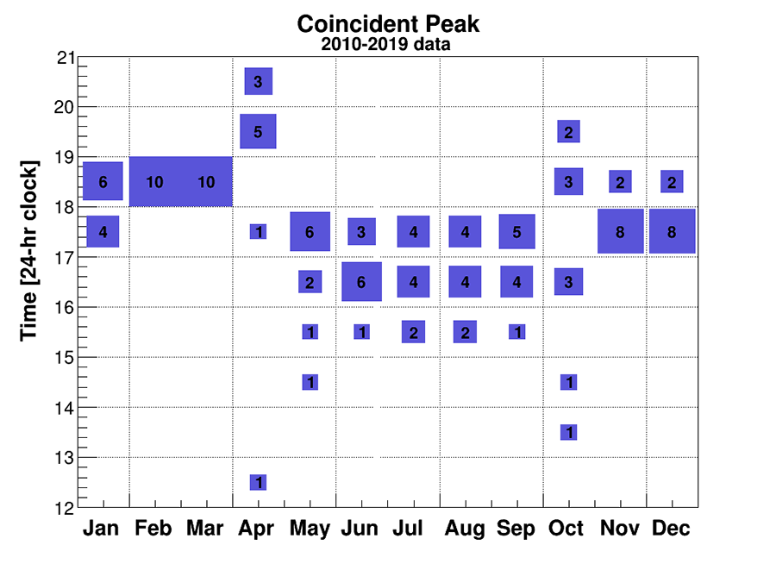
Peak Hour Occurrence
Notes:
Any questions so far?

Slide 10

Tools
Facility Demand
  Your own peak
  ElectriConnect (MV-Web)
  Identify Energy Use Patterns
  Want access to tool? Email to utilitiescustomeraccounts@fcgov.com
Coincident Peak & Conservation Events
  Your contribution to the NoCo electric grid peak
  Peakload page (fcgov.com/peakload)
  Email notifications (SMS coming soon)
  OpenADR (building automation)

Slide 11
Conservation Events
It is not possible to know when the Peak Hour will be.
However with analytics and operational experience we can identify a few hours per month as “candidate hours”.
Conservation Events are
Candidate hours for peak hour of the month
If you reduce energy use
during a conservation event
you can save $

Slide 12
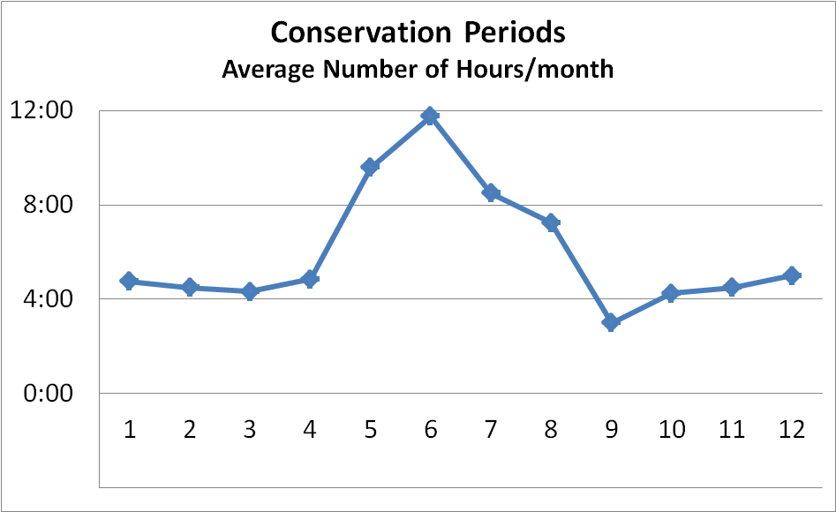
Conservation Events
Hours
Month
Typically around 75 (and up 100) hours/year
< 1% of the hours of the year
Notes:
Any questions so far, before I move into the actual tools (peakload page, notices and automation)

Slide 13
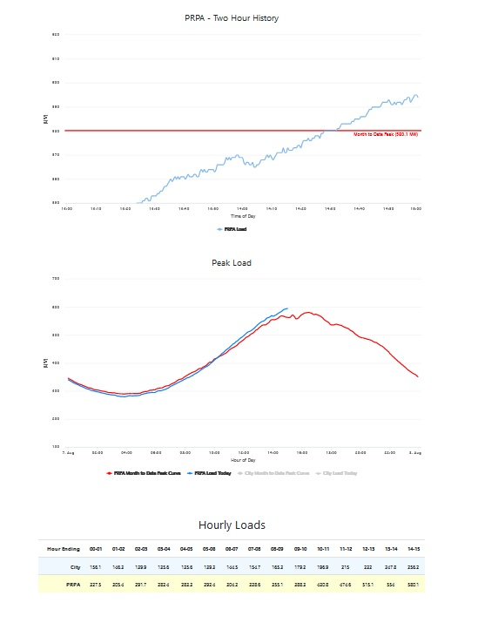
Peakload Page http://fcgov.com/peakload
Current load information
  Trends in the load
  Information on upcoming “conservation events”
Historical data
  Previous Peak Hours
  History of Conservation Events
Want access? Visit the page and follow instructions

Slide 14
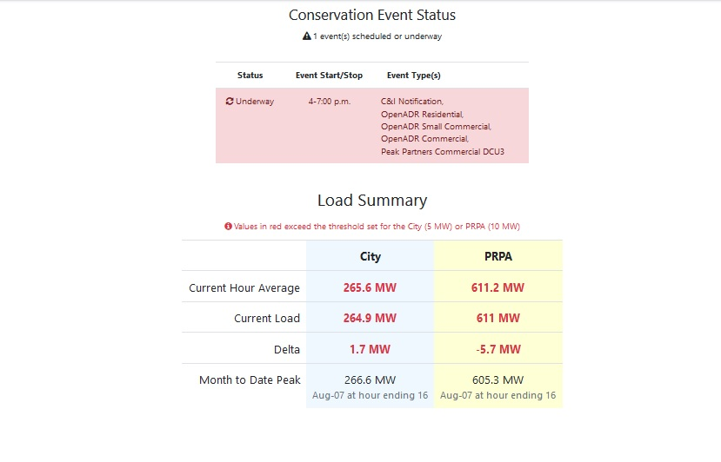
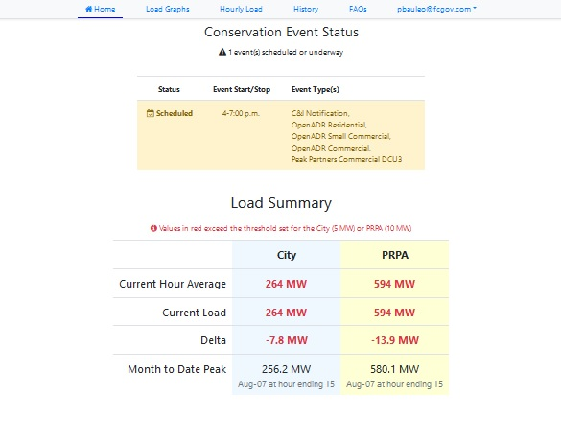
Peakload page http://fcgov.com/peakload

Slide 15
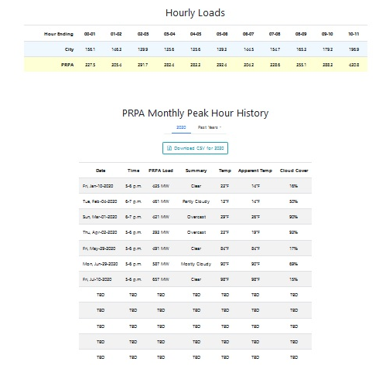
Peak Hour History
Notes:
Questions on the peakload page?

Slide 16

Email Notification
Sign up for Email Notifications (utilitiescustomeraccounts@fcgov.com)
Emails include
Advanced notice of upcoming event
  Often 1 (and up to 2) hrs notice
Details on start/end time
Event reminders (Starting now, Ending now)
Updates (shortening, canceling)
Coming soon: SMS notices (late Q4 2020)

Slide 17
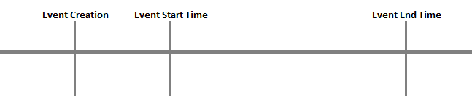
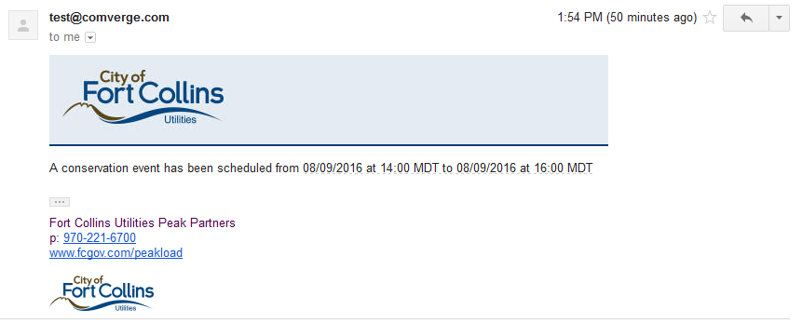
Email Notification Sample
1:00 PM
2:00 PM
4:00 PM
1:01 PM (3 minutes ago)

Slide 18
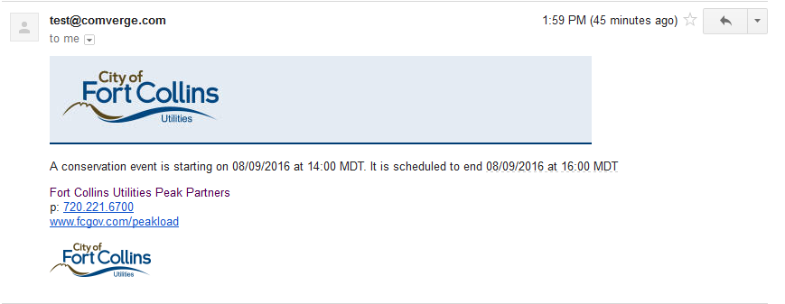
Email Notification Sample
1:59 PM (1 minute ago)
1:00 PM
2:00 PM
4:00 PM
2:01 PM (3 minutes ago)

Slide 19
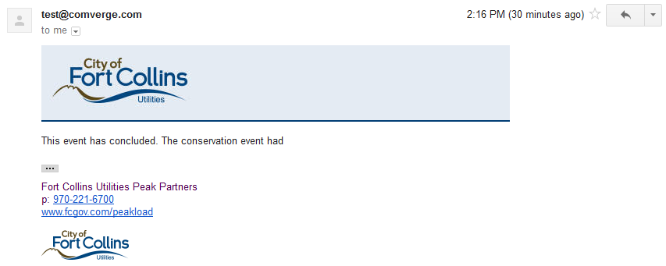
Email Notification Sample
1:00 PM
2:00 PM
4:00 PM
4:01 PM (3 minutes ago)
Notes:
Questions on the notices? As I said, there will be SMS notices coming soon.

Slide 20


How about automated response?
If you have a
Building Automation System
Turn off lights
Setback HVAC
Turn off higher stages of HVAC system
…..
If you have notification of upcoming events
Precool/Prewarm your building
Run up compressors before event (fill up tanks for compressed air)
Other things?

Slide 21

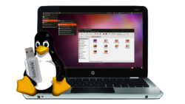


OpenAD… what?
OpenADR is a protocol designed to exchange information on demand response (conservation events)
It runs over internet
It is meant to be used in building automation systems
It is supported by many vendors (like Wi-Fi)

Slide 22
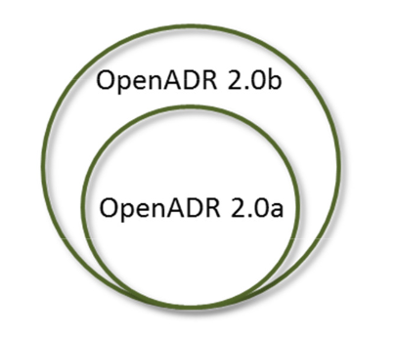
OpenADR Lingo
OpenADR 2.0a and 2.0b:
  Basic and Deluxe versions
  We support both
VTN: Virtual Top Node
  Typically the Utility
  Sends information out
VEN: Virtual End Node
  Typically a commercial or industrial facility
  Responds to VTN information (reduces energy use)

Slide 23
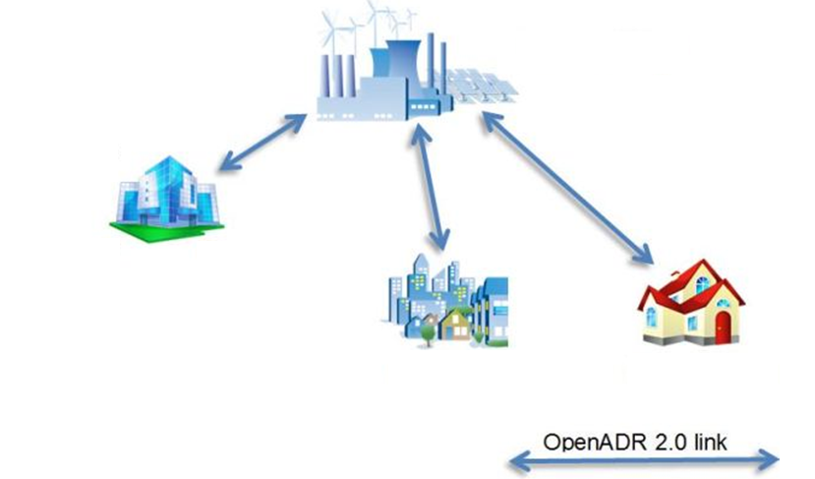

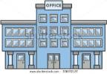
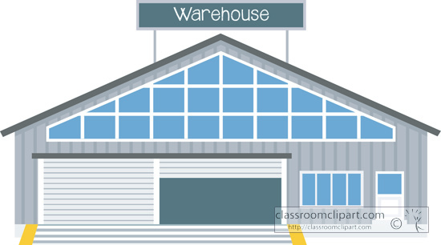
OpenADR and other protocols
Any other link
(Modbus, BACnet, LonMark, etc)
Utility
Customer C
Operations
Building
Customer B
Customer A
Customer C
Multiple locations
Notes:
Are you confused enough? Any clarifying questions?

Slide 24
Implementing
OpenADR in your facility
If your Building Automation Systems support OpenADR
  Work with your automation provider to implement it
  Work with Fort Collins to get access to VTN (Top Node)
If your Building Automation Systems does not support OpenADR
  Look for interfaces
    Relays (ISY994r, Eagle200, etc)
    OpenADR 2 Modbus / OpenADR 2 BacNet
  Often one device is enough
If you don’t have any automation system
  Look for interfaces with relays (ISY994r)
  Each HVAC/Compressor/Equipment will need its own ISY994r
Notes:
Questions?

Slide 25
Summary of Tools
Facility Demand (~ $9.5/kW)
  Your own facility peak
  ElectriConnect (MV-Web)
  Sign up via utilitiescustomeraccounts@fcgov.com
Day of the Month

Slide 26
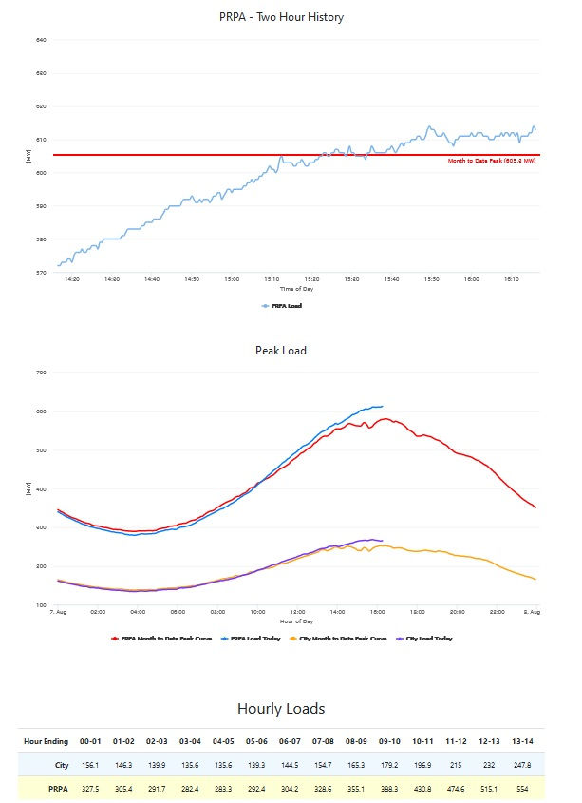
Summary of Tools (cont’d)
Coincident Peak (~$11/kW or 14.5/kW)
  Your contribution to the regional peak
http://fcgov.com/peakload
  Sign up via above URL
  SMS notices coming soon
    Sign up via peakload website
Email notices and OpenADR enrollment sign up via utilitiescustomeraccounts@fcgov.com

Slide 27
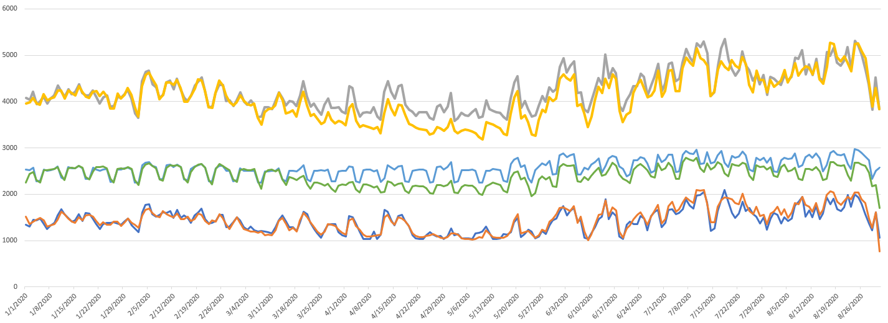
COVID-19 Impact on loads
Citywide
Energy (MWh/day)
Commercial
Residential

Slide 28
Thanks!
Pablo Bauleo, Ph.D.
Sr. Energy Services Engineer
Fort Collins Utilities
pbauleo@fcgov.com

